Slide 1


Slide 2



CONCEPTS
How to brainstorm solo
Notes:
It’s thrilling to brainstorm as a team. You get to tap into each other’s energy to inspire new ideas and work through issues and (hopefully) bask in the genius outcomes. But occasionally you’ll need to brainstorm before a group session. You may even find yourself working on an individual project and needing to come up with creative solutions. Suddenly, the only energy is yours, and that can feel scary and intimidating.
Here’s a secret, though: you can come up with incredible ideas on your own using some of the same techniques you’re comfortable using with your team. And the best part? You don’t have to share the break room snacks. Brainstorming on your own is a valuable skill that’s great for generating creative solutions and ideas. And it’s downright enjoyable, too. Here’s how to solo brainstorm.

Slide 3

CONCEPTS
Benefits of individual brainstorming
Notes:
Most successful artists create their work by being disciplined. Stephen King begins writing at about 8:30 every morning and sits in the same seat with the same papers arranged around him. Egon Schiele completed dozens of pencil sketches before attempting a final draft. Jazz genius Eubie Blake spent his childhood practicing the piano. Most incredible artists understand that creativity is harnessed through rules and disciplined. Put aside the stereotype of the frenetic oil painter or the misanthropic novelist—the vast majority of our most treasured works of art, literature, and music are born of sheer hard work.
That means if you want to come up with truly exceptional ideas, you’ll need to harness them through that magical combination of discipline and effort. Brainstorming is a critical tool for this.

Slide 4
CONCEPTS
Here are the primary benefits of brainstorming:
Prevents outside intervention—Working with a team means you may be reluctant to share your ideas or be influenced by others’ ideas. By brainstorming alone, you’ll only be left to contend with your own mind.
Breaks routine—You’ll notice most of your day is likely done by rote. Brainstorming helps inspire creativity by allowing your brain to think in a new way.
Inspires focus—When you’re focusing on finding one solution, it’s much easier for your brain to work.

Slide 5
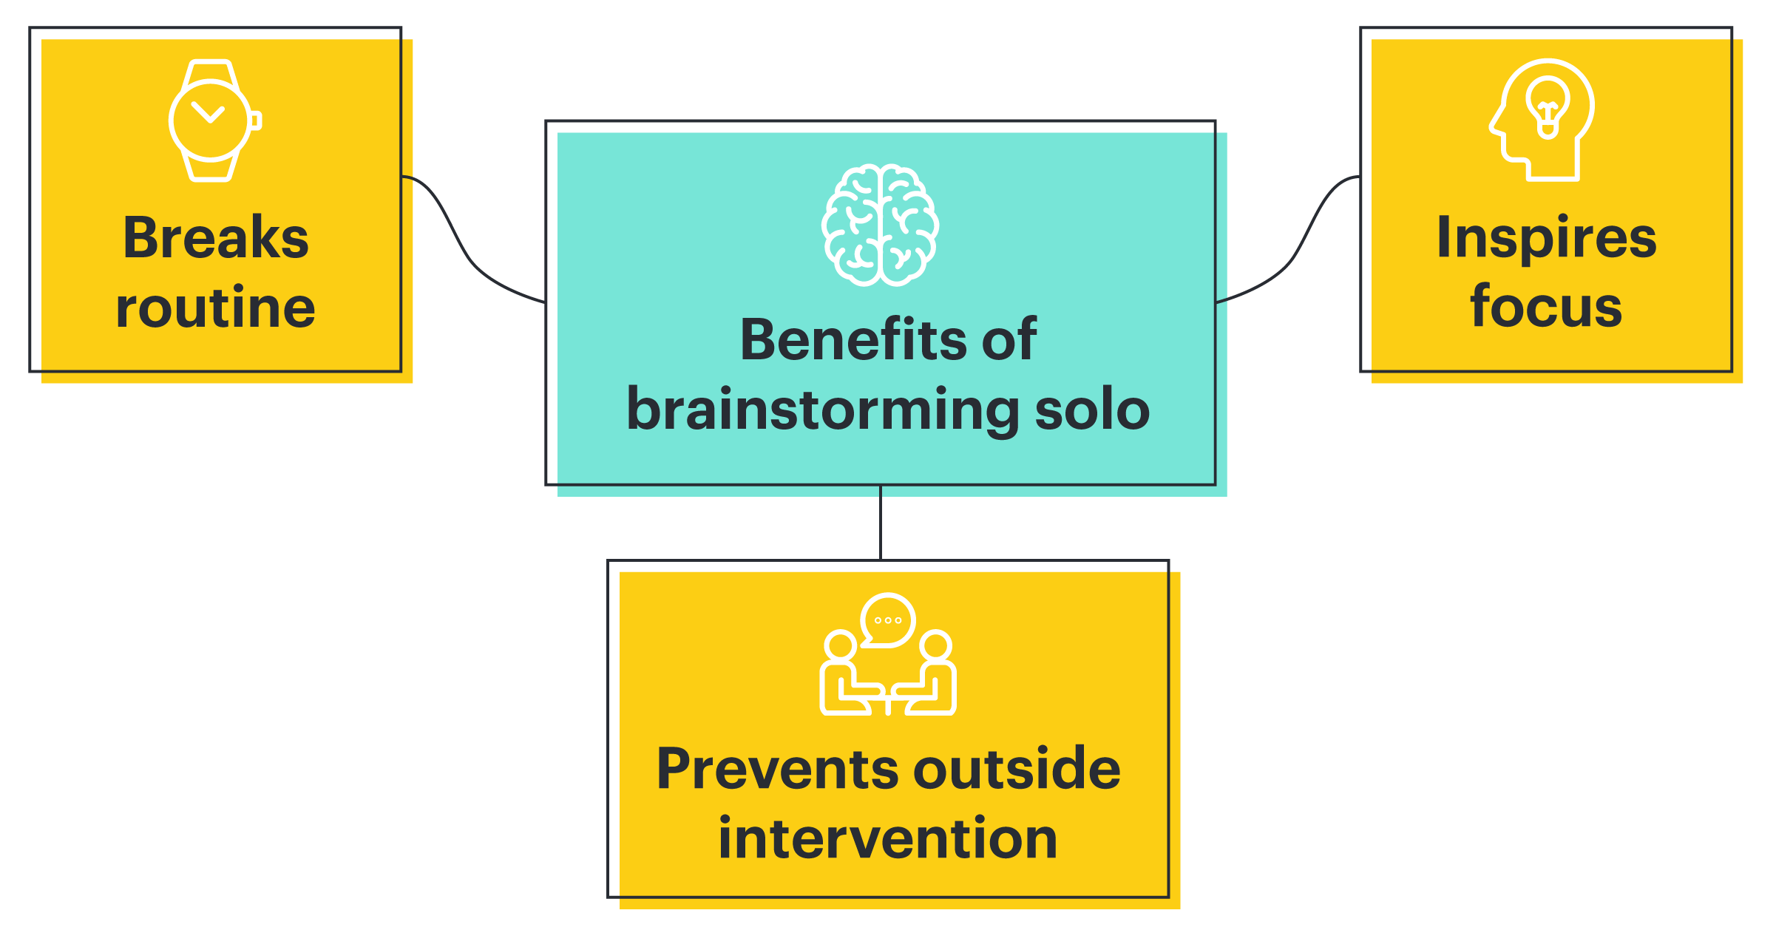
CONCEPTS
Examples of when you should brainstorm alone
Notes:
Individual brainstorming has its place. Want to respond to an email quickly? Probably not a good time to brainstorm. Interestingly, moderately complex solutions are best left to the group, but either end of the spectrum is best for an individual: either very simple ideas or very complex ones.

Slide 6
CONCEPTS
Here are some times when solo brainstorming might be best:
Coming up with a new company or product idea
The direction for an ad campaign
A solution for supply chain issues
The color palette for a brand
The look for a photoshoot
The concept for hardware design
Preparing for an important presentation with the rest of the team
Notes:
It’s also worth noting that some people simply brainstorm better alone. Introverts generally feel like group brainstorming is an exercise in torture. That means that, for them, brainstorming alone through a moderately complex solution may yield better results than brainstorming with a group.
Every individual has their own set of conditions that are best for inspiring creativity. And that means, of course, that some people may struggle with brainstorming on their own. But there are ways to make the best out of a situation that may be initially frustrating. Keep reading.

Slide 7

CONCEPTS
Individual brainstorming techniques
Notes:
Don’t think of brainstorming as something that needs to involve endless cloud bubbles. Brainstorming can happen in a lot of different ways. Here are a few favorites:

Slide 8

CONCEPTS
1. Brainstorm on the move
Notes:
Moving meditation is a fantastic way to inspire creativity and was a favorite technique of Romantic poets and authors. To do this: get outside and begin thinking about the problem as you walk. This kind of automatic moving helps stimulate the creativity receptors in your brain. It’s important to note that walking meditation is ideal because you don’t have to focus much on the exercise itself. Swimming, running, and walking are great times to brainstorm. Ballet dancing and Crossfit are not times to brainstorm.

Slide 9
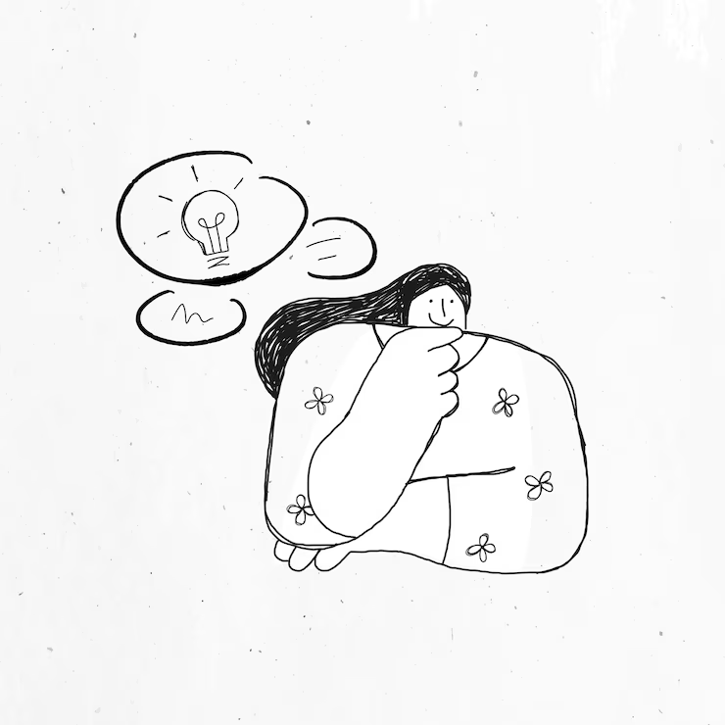
CONCEPTS
2. Stop thinking
Notes:
You read that correctly. Instead of sitting at your desk trying to be creative, go clean the bathroom. Go grocery shopping. Take a nap. Answer some emails. Give your brain some breathing room and it may surprise you what kind of creativity arises.

Slide 10

CONCEPTS
3. Start writing
Notes:
Most writers prewrite before they start working on a creative piece. This trains your brain to begin thinking creatively. To freewrite, simply write about anything that comes to you. It could be about circus animals or electrolytes or scented candles. Just write about anything for five minutes, then begin thinking about the solution you wish to find.

Slide 11

CONCEPTS
4. Make a mind map
Notes:
To create a mind map, write the question you wish to find in the center of a piece of paper or use cloud-based software to help you keep your thoughts organized. For instance, if you’re trying to come up with ideas for a photoshoot, your mind map may have “Fall 2022 Photoshoot” in the middle. Then, draw branches off the center prompt and begin writing down ideas in their own bubbles. Keep writing down anything related to each bubble to refine your ideas.

Slide 12
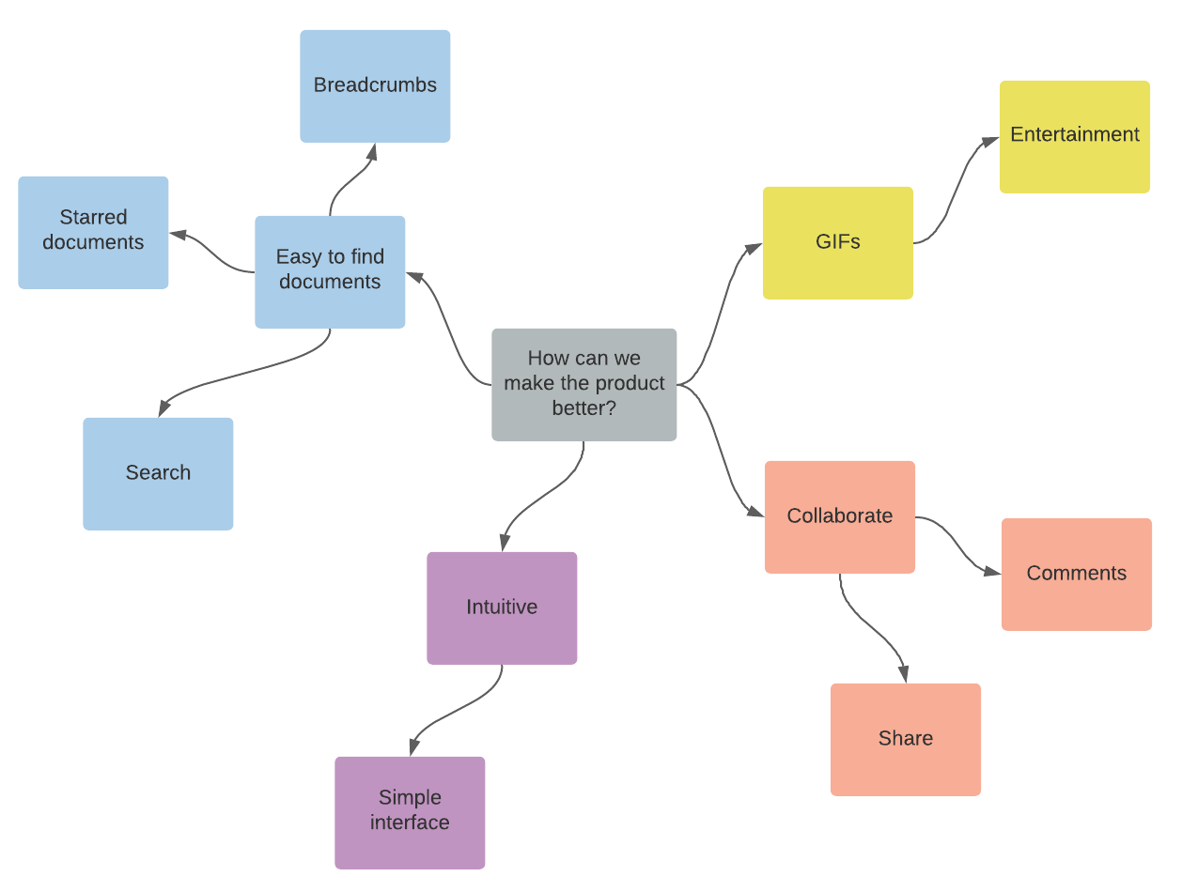
CONCEPTS
5. Use word association
Notes:
This is less regulated than a mind map, but still counts as brainstorming. At the top of your paper, write down the goal or question for which you’re hoping to generate ideas. Below that, write down the first four or five words that come to mind when you think of that solution. From there, jot down the first words you think of when you hear each of those words.

Slide 13
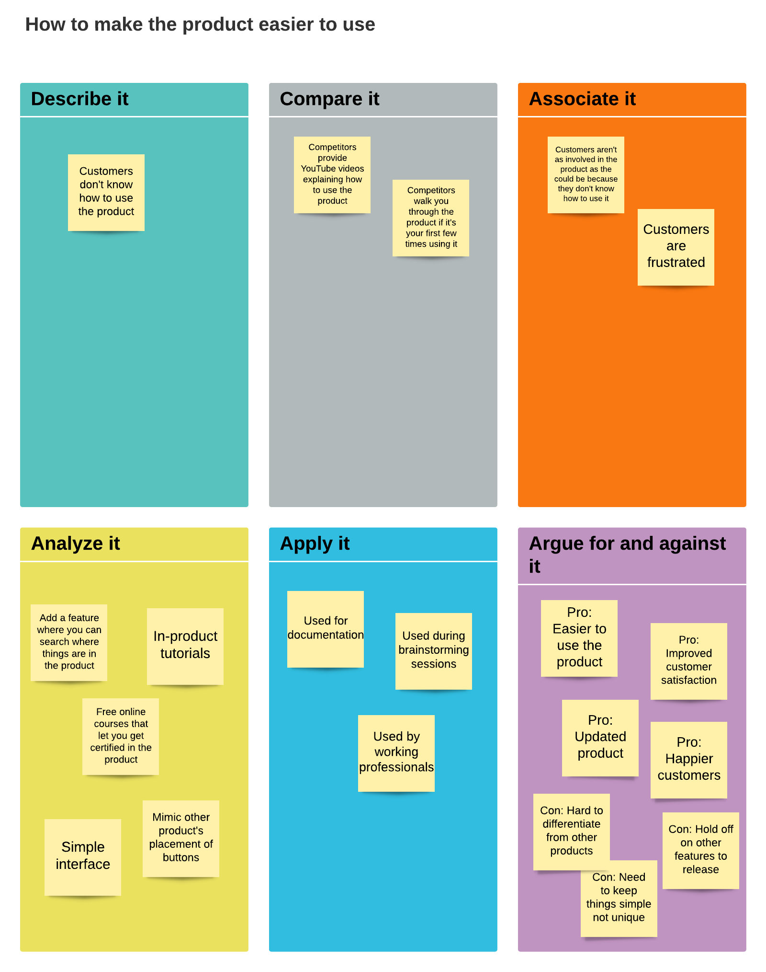
CONCEPTS
6. Try cubing
Notes:
Cubing involves looking at an issue or an idea from several different angles. To do this, write down the question or desired solution at the top of a piece of paper.

Slide 14
CONCEPTS
Then write down the following answers to these questions:
What’s the problem?
What’s the competition doing?
What do I think of when I think of this problem?
What are some possible solutions?
What are the real-world situations?
What are the pros and cons?

Slide 15

CONCEPTS
How to take the results of your solo brainstorming to a group
Notes:
So you’re a genius, as it turns out. You’ve come up with some stellar ideas through your brainstorming efforts. But now you’ll need to convince your group of your solution. How?

Slide 16

CONCEPTS
Make it visual
Notes:
It’s much easier to present your ideas when they’re written down. Make a presentation showcasing your ideas so your group better understands your solution.

Slide 17

CONCEPTS
2. Predict objections
Notes:
It’s likely your group will spot holes in your idea. Head off those objections by presenting solutions to likely objections.

Slide 18

CONCEPTS
3. Come up with three suggestions
Notes:
If you only have one idea, then just present the one. But it’s best to have three suggestions and present the strongest suggestion first.
Contending with your own mind can sometimes be an exercise in frustration, but it can also be an incredible opportunity to become more acquainted with your own brilliance. You might be surprised at how much you enjoy being creative when you have a few parameters to give you encouragement. Try brainstorming, and we guarantee you’ll be delighted at the solutions you already have locked inside your brain.

Slide 19

CONCEPTS
The pros and cons of group brainstorming
Notes:
When you think about it, most businesses could benefit from having a few more creative ideas at their disposal. It’s creativity that drives growth, innovation, and motivates teams.
Looking for a way to tap into the underlying creative potential of your company? Try group brainstorming.
Group brainstorming can generate an undeniable synergy between employees that brings everyone together. Done correctly, group brainstorming can produce solutions and transform organizations at a rate greater than the sum of every individuals’ contributions. Other times, not so much.
By understanding the pros and cons of brainstorming, that success ratio will only improve. Plus, having this knowledge can make brainstorming more enjoyable for everyone involved.

Slide 20

CONCEPTS
Benefits of group brainstorming
Notes:
Sure, working on your own might seem easier. Or at least, less complicated. But there’s a definite advantage (or five) that comes from working together as a group ready to brainstorm ideas.
Whether your next collaborative brainstorming is being forced upon you or you’ve now become the driving force behind more ideation sessions at your business, the many reasons why you should conduct a group brainstorming are reasonable, logical, and yes, compelling.
Let’s begin with the most obvious motive to host a brainstorm with your group…

Slide 21

CONCEPTS
It provides multiple (often diverse) perspectives to use
Notes:
Try as we might, we can’t always go it alone. This isn’t an admission of weakness. Actually, it’s more of an acknowledgment that some problems call for more than one problem solver.
And it’s not just hosting any group. Opt for diversity. Choose participants from various departments and with a range of backgrounds, ages, and life experiences. This will bring refreshing, diverse, and surprising ideas to the table.

Slide 22

CONCEPTS
It helps avoid biases toward any particular viewpoint
Notes:
Solitary problem solving is arguably more efficient. But producing ideas all by yourself lacks a counterbalance to the existing beliefs, opinions, and biases that determine how you think.
By inviting others who perceive the world (and your organization’s business challenges) in a different light, you increase the chances of arriving at a solution you could never anticipate or produce on your own. With the right group of participants, partiality is also kept in check.
If anything, the presence of differing viewpoints leaves everyone open to new possibilities.

Slide 23

CONCEPTS
It often generates more ideas in a short period of time
Notes:
If you can generate more ideas, it becomes more likely that you’ll stumble upon a greater amount of good (and possibly great) ideas. If that volume can be achieved sooner, even better.
Over the course of a productive brainstorming session, a group can quickly come up with dozens of ideas, each of which can spark a dozen more. The group dynamic can be used to commit each participant to achieve a certain number of ideas within the allotted time limit.
In any case, the output of a group is far greater than any one person can hope to produce.

Slide 24

CONCEPTS
It creates opportunities to explore each other’s ideas
Notes:
Think about it: the opportunity to explore one another’s ideas is at the crux of brainstorming.
As you might expect, bouncing around (and considering) a number of solutions at once can prompt a rapid-fire of new idea associations. This is sometimes called a popcorn share.
This group problem-solving approach is simple: one person presents an idea or solution. Then, everyone else takes a turn to build on the concept that has been shared. In the end, each person feels they’ve equally contributed a missing piece to the solution.

Slide 25

CONCEPTS
It builds up camaraderie and fosters a sense of buy-in
Notes:
Perhaps one of the best reasons to encourage group brainstorming within your organization is that when teams work together to solve problems, they also build stronger relationships.
Group ideation sessions allow people who might not normally get the opportunity to work together on a project. Building camaraderie through such interactions breaks down silos and prompts everyone to see themselves as stakeholders.
As stakeholders, participants have a vested interest in the brainstorm’s outcome. A big plus.

Slide 26

CONCEPTS
Challenges of group brainstorming
Notes:
The disadvantages of group brainstorming should be familiar to anyone who has attempted to assemble a team or coordinate the work of contrasting personalities to solve a problem.
Decision making becomes more complicated. Disagreements are sure to arise. Some people are less enthusiastic than others about the opportunity to participate. And it can add another meeting to their day-to-day work responsibilities.
But don’t get too discouraged. Where there are group brainstorming challenges, there are also ways to overcome them.

Slide 27

CONCEPTS
It turns brainstorms into disorganized free-for-alls
Notes:
Constructing a new team to solve a problem is exciting.
If you’re not careful, however, brainstorming as a group can result in disorganized conversations and free-for-alls that fail to produce any actionable ideas. This is why it’s critical to create a brief and agenda ahead of time before your first group brainstorm.
The brief gives context to the problem being solved and outlines the brainstorm’s purpose. Having a clearly outlined purpose makes it easier for participants to stay on task. The agenda is simple. Take a few moments to address background questions. Then, apply positive pressure to produce by allotting a set amount of time (e.g. 30 minutes) to generate raw ideas. Review afterward.

Slide 28

CONCEPTS
It enables too much groupthink and too few original ideas
Notes:
Feeding off each other’s ideas is great. Until it’s not. Sometimes, it causes teams to get too focused on a single idea, losing their individual sense of creativity. This is called groupthink.
To counter this, introduce an element of candor into the mix. Create an environment where participants feel safe to express their opinions and ideas. With this type of freedom, people won’t get fixated on the first solution and are likely to share their candid, unfiltered views.
At the end of the brainstorm, the team takes the remainder of their time to focus on the most promising of these divergent, freeform ideas.

Slide 29

CONCEPTS
It allows a handful of people to dominate the conversation
Notes:
Chalk it up to human nature. In any group, there’s always one person that takes over, makes their opinion known, and expects everyone else to fall in line. Brainstorms are no different.
Dominant personalities hinder the creative process by intimidating other team members or making them feel reluctant to share a dissenting opinion. Fortunately, there are a number of tactics for handling those dominating meeting personalities.

Slide 30
CONCEPTS
Acknowledge comments by the dominator without yielding the floor.
Redirect with phrases like “Interesting. What do the rest of you think?”
Call on others by name to contribute.
Ask a question to briefly distract the dominator to help regain the floor.
Notes:
Many dominant personalities actually mean well and often contribute constructive ideas. By politely (but firmly) countering their dominance, you ensure better brainstorm productivity from the group as a whole.

Slide 31

CONCEPTS
It makes it easy to not participate
Notes:
Of course, some team members don’t mind letting others dominate the conversation. Many prefer hiding in the background and relying on others to come up with the bulk of the ideas.
It’s tempting to expend less effort when working collectively or in a team than when we work individually. This is called social loafing or free riding. Not unlike the bystander effect, people feel less compelled to act if someone else steps up.
Similar to the strategy used with dominating personalities, make a point of calling on those who are not actively participating in the group brainstorming. Offer positive reinforcement to team members who seem apprehensive or intimidated to share ideas within the group.
Getting comfortable with brainstorming ideas as a group can be difficult, at least at first. But it’s worth the effort. Keep in mind, every team member can make a valuable contribution to the team. Every idea is worth exploring further. And there’s no such thing as a bad question.

Slide 32







/ethnuscodemithra
Ethnus Codemithra
/ethnus
/code_mithra
THANK YOU
https://learn.codemithra.com/
codemithra@ethnus.com
+91 7815 095 095
+91 9019 921 340

Slide 33
CONCEPTS

Slide 34
CONCEPTS

Slide 35
CONCEPTS

Slide 36
CONCEPTS

Slide 37
CONCEPTS

Slide 38
CONCEPTS

Slide 39
CONCEPTS

Slide 40
CONCEPTS

Slide 41
CONCEPTS

Slide 42
CONCEPTS

Slide 43
CONCEPTS

